Slide 1


STOCK PRICE PREDICTION (ML)
Presented By:→
YASHODEV ROUT
SUMAN SOURAV DASH
SRITAM MOHAPATRA
ASHIS KUMAR BHUYAN
Getting Started

Slide 2

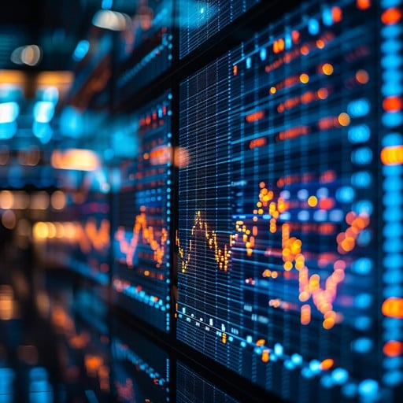
CONTENTS
Introduction
Project Overview
Tools Used
Datasets Used
Workflow
Visualization & Deployment
Sample result Visualization
Conclusion
.

Slide 3
Stock price prediction means guessing a stock’s future price. People use past data, news, and computer models to spot patterns. It’s not always accurate, but it helps in making better decisions.
Trading using AI means using smart computer systems to buy and sell stocks. AI looks at large amounts of data to find patterns and trends. It can make fast and smart decisions without human help. This helps traders reduce risk and increase profits.
INTRODUCTION
Preferred Stocks
Preferred stocks deliver fixed dividends, offering steadier income while typically lacking voting privileges in companies.

Slide 4
PROJECT OVERVIEW
01
Our project focuses on predicting future stock prices using machine learning techniques.
02
Our model uses the historical data of stock’s for training.
We use the Linear Regression model.
03
Trading Venues Worldwide

Slide 5
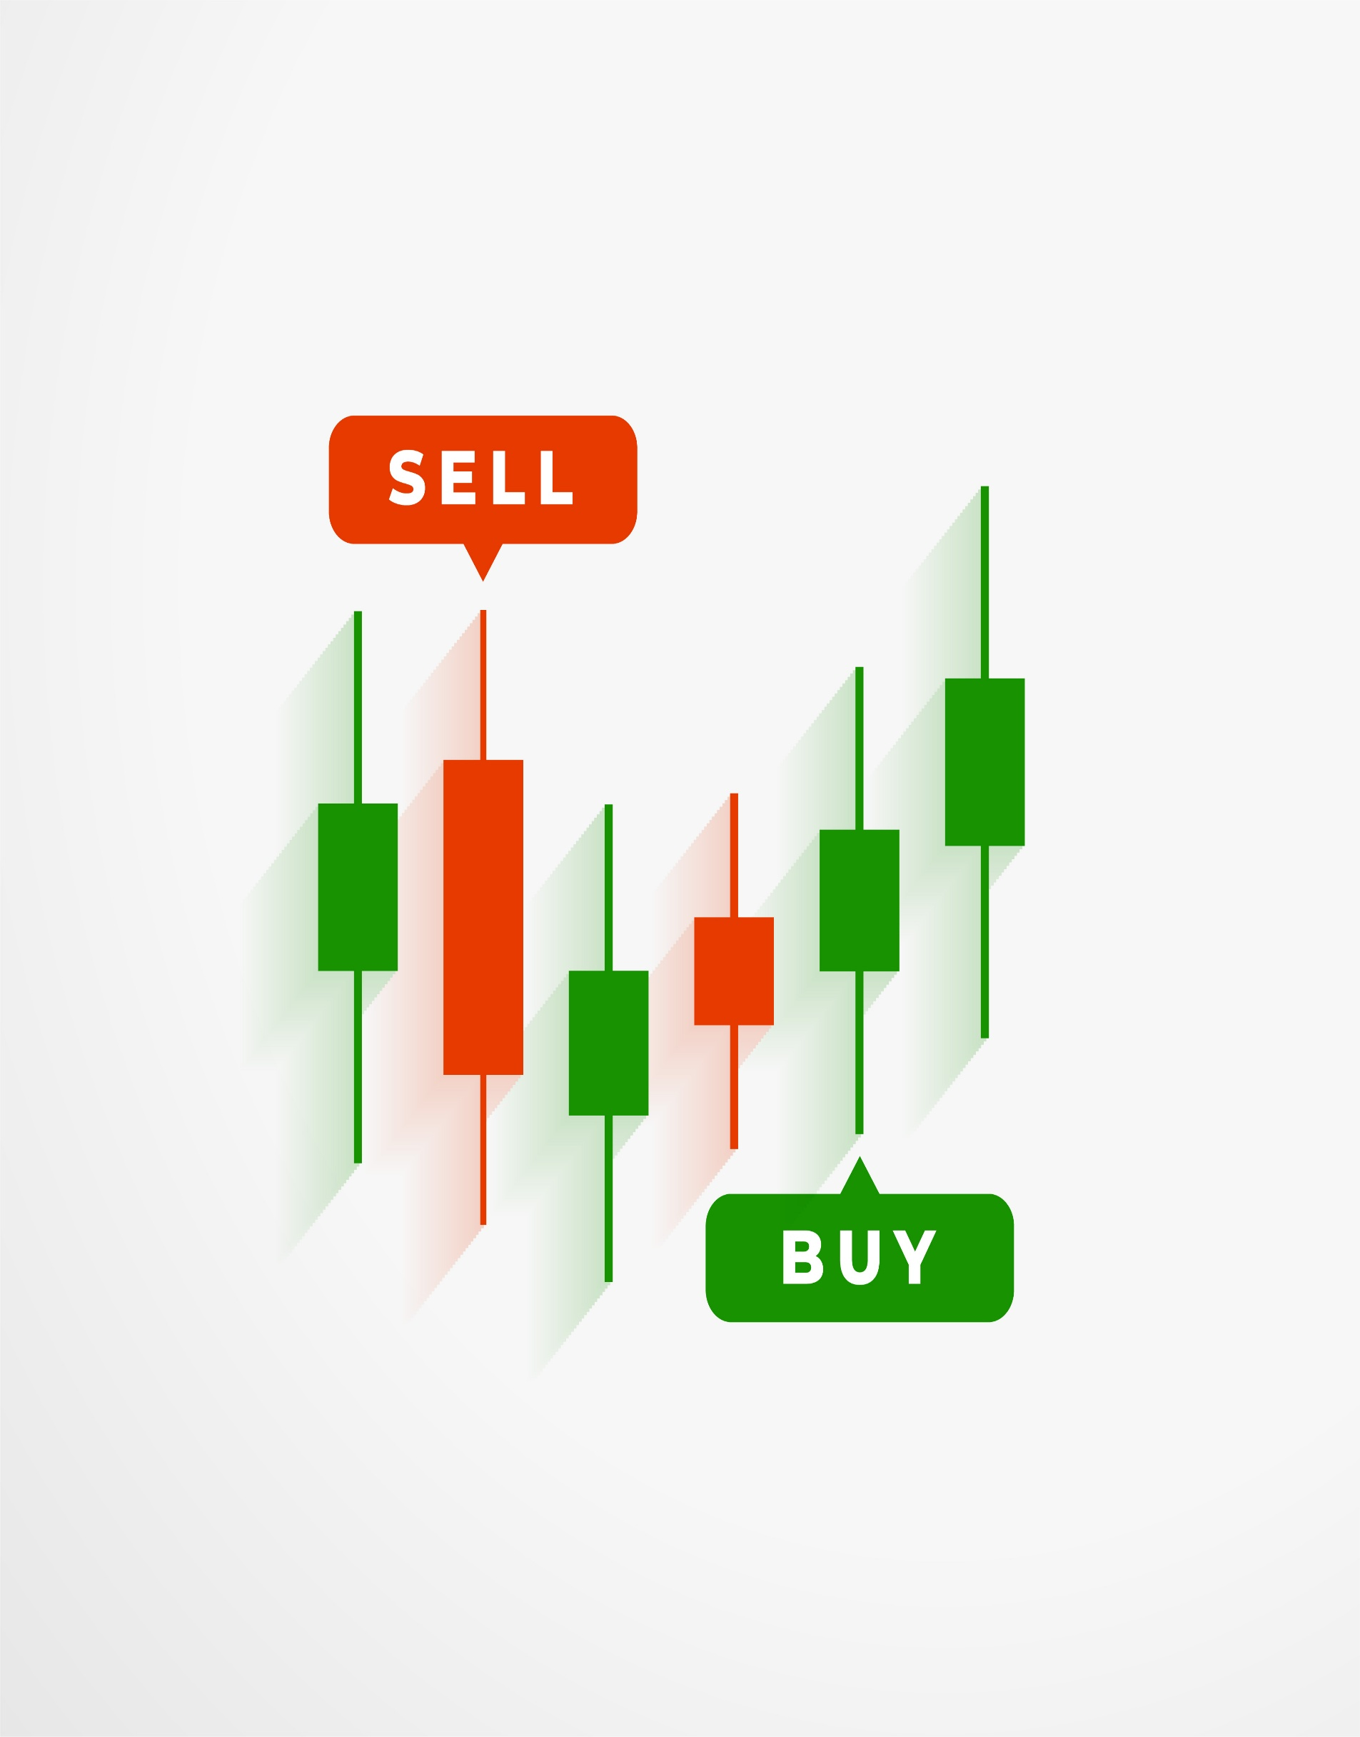
TOOLS USED
Machine Learning Features
Pandas / NumPy for data manipulation
Matplotlib / Seaborn for visualization
Scikit-learn for preprocessing
Flask for web interface
Pickle file for saving the trained model
01
.
03

Slide 6
DATASETS USED
We are using 5 datasets for train model.
NIFTY 50 Daily Dataset from Kaggle
TCS Daily Dataset from Kaggle
HAL Daily Dataset from Kaggle
HYUNDAI MOTORS Dataset from Kaggle
ITC Dataset from Kaggle
Technique to Maximize Returns

Slide 7
WORKFLOW
Our model predict the closing price of stock’s according to the historical price of the stock’s dataset.
The model is trained with the help of Linear Regression.
The model is using the 80% of data for training & 20% data for testing. (test_size=0.2)
The model r2 score is around 0.9989.

Slide 8
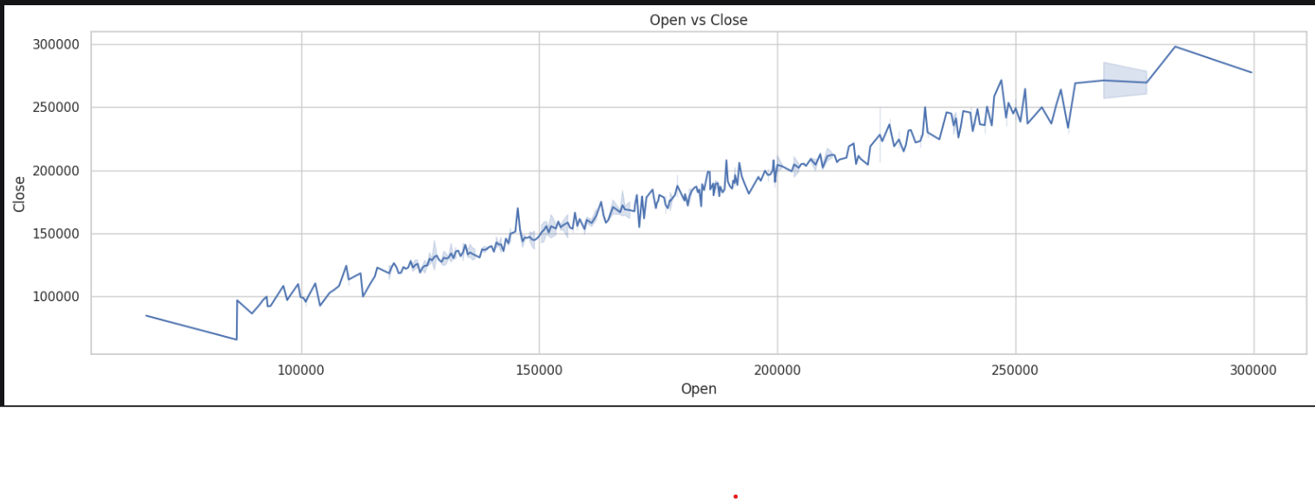
VISUALIZATION & DEPLOYMENT
The graphs are used to do visualization and data analysis.
The backend deployment is done by the Flask framework.
We are using HTML , CSS for designing the web interface.
02

Slide 9
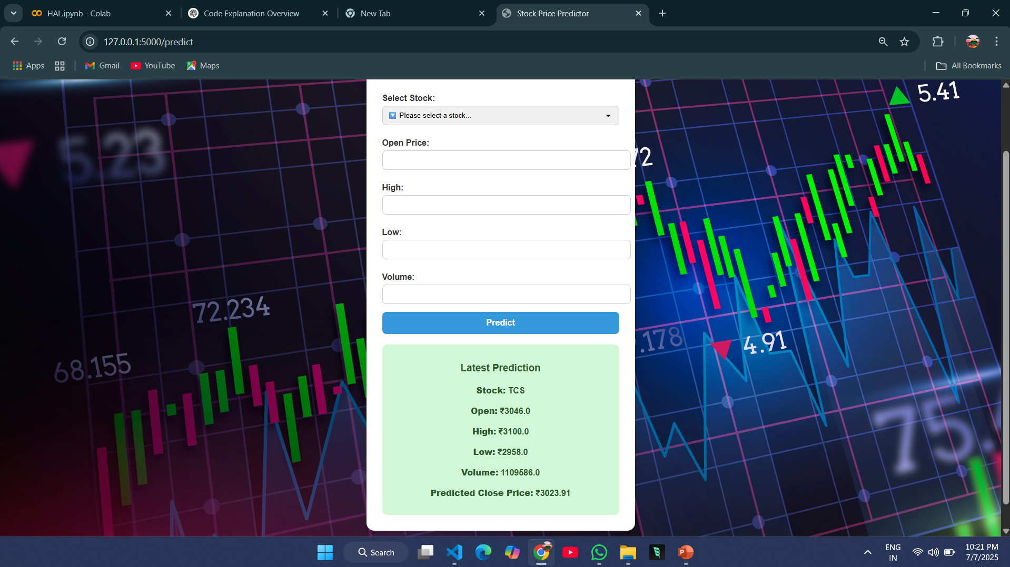
SAMPLE RESULT

Slide 10
.
CONCLUSION
Stock markets often change and are hard to predict.
Prediction models can help, but they are not always correct.
AI and machine learning have made some predictions better.
Good data and choosing the right features are very important.
But it should be used along with human thinking.
Social Responsibility
Socially responsible investments support ethical practices, enhancing community development and fair labor standards.

Slide 11
THANK YOU

